Slide 1
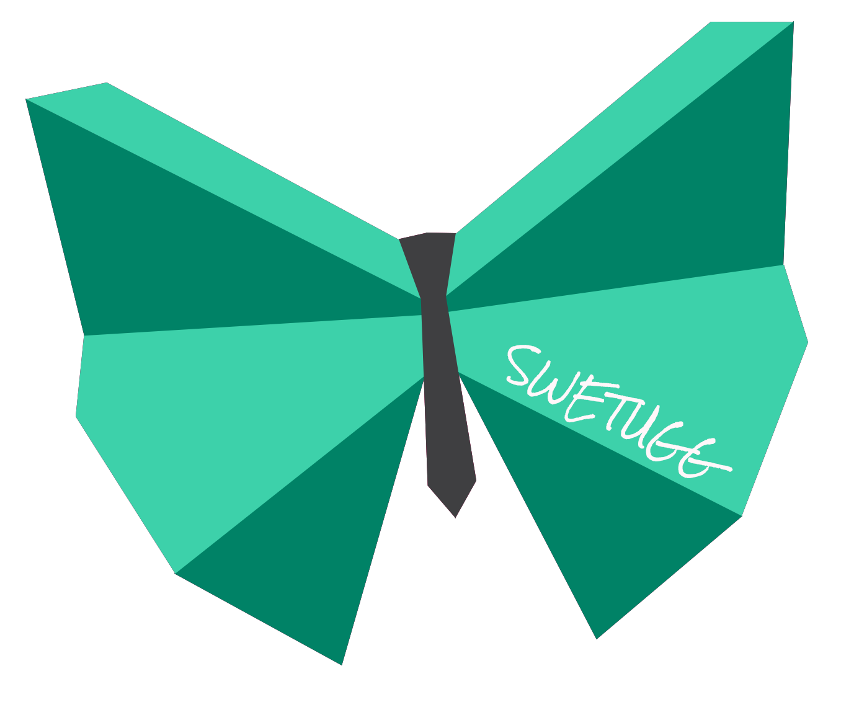




From Cloudy to Clear: Demystifying Azure Authentication
Emanuel Palm Cloud Specialist & Microsoft MVP @ Unwonted
@PalmEmanuel

Slide 2
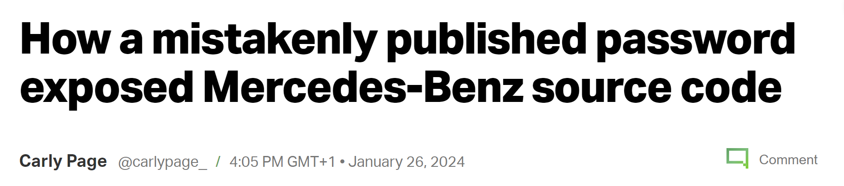
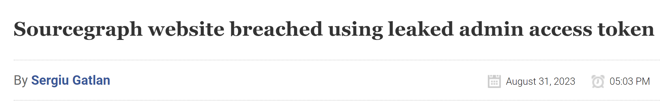
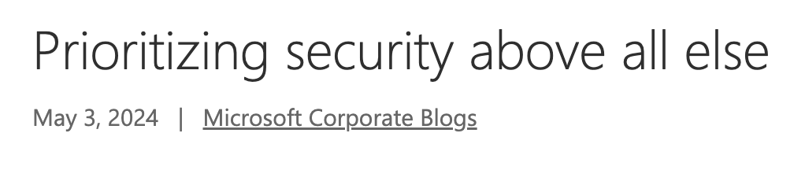
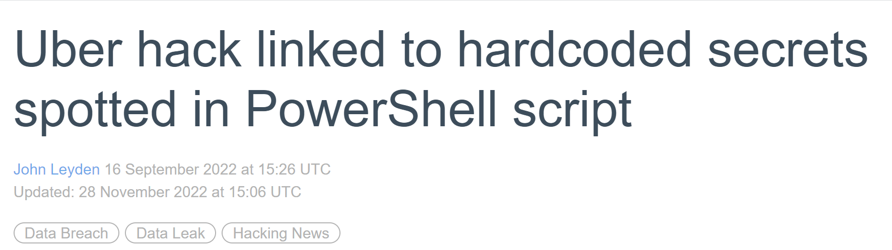
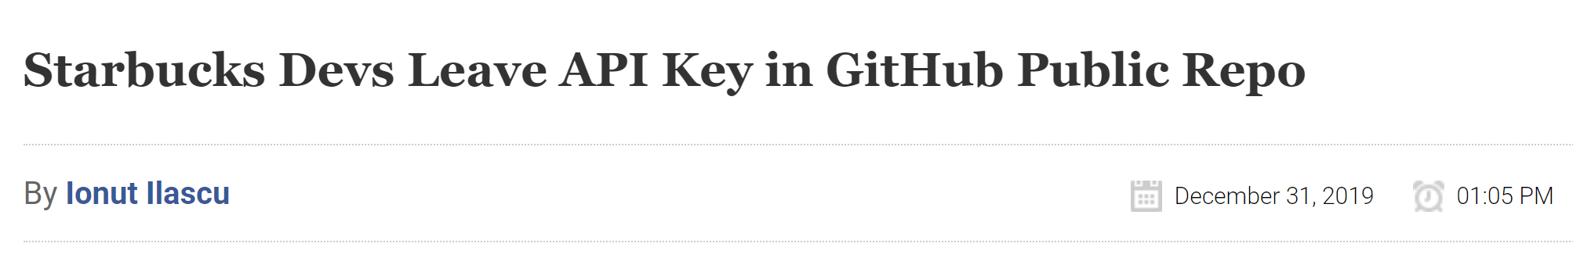
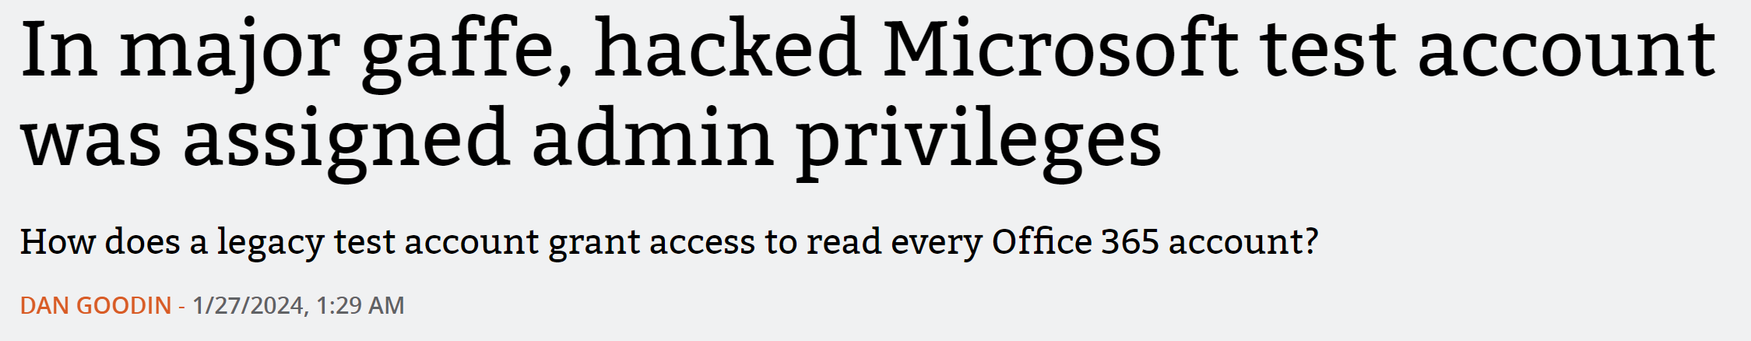

Slide 3
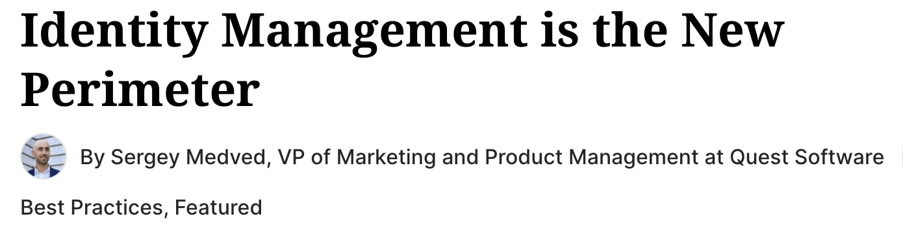
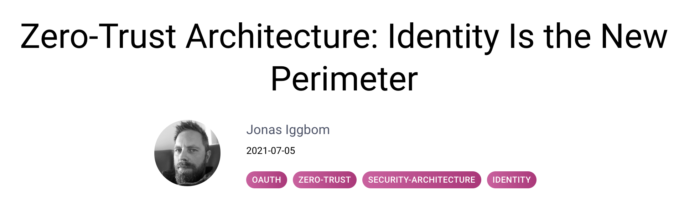
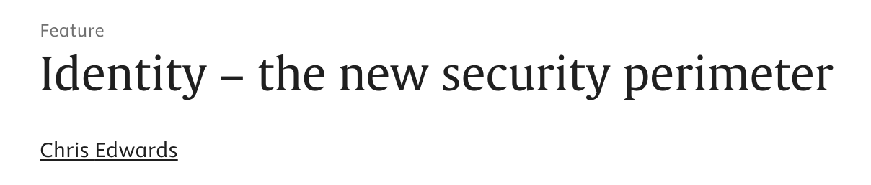
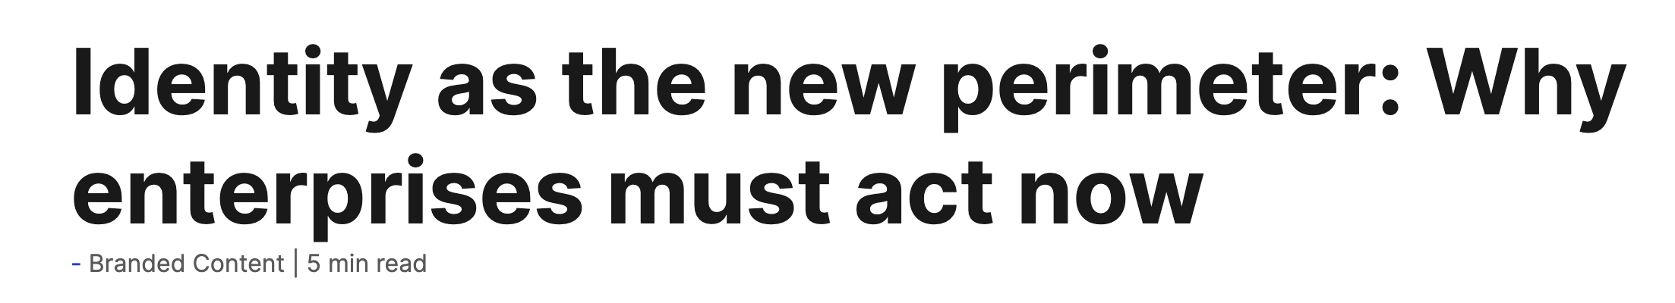

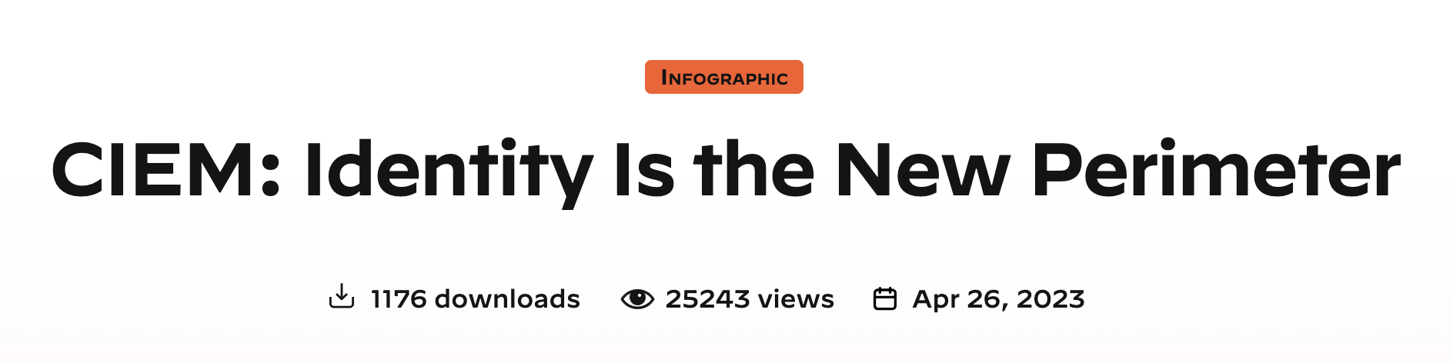
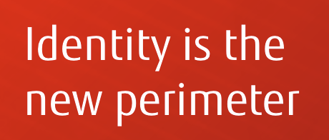
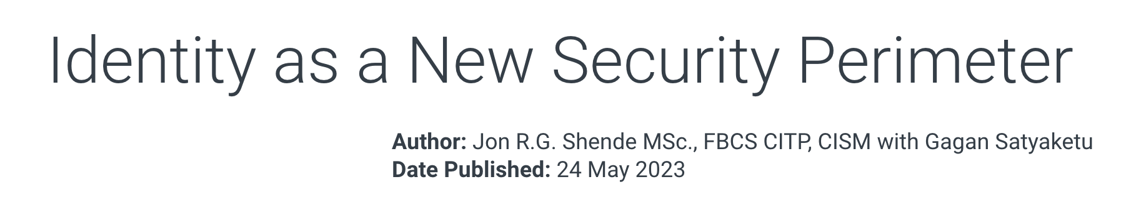

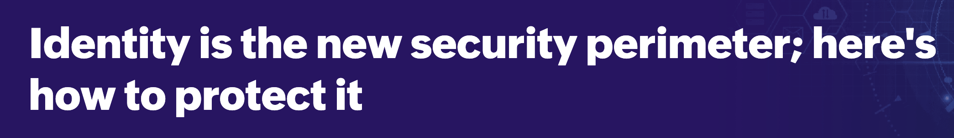
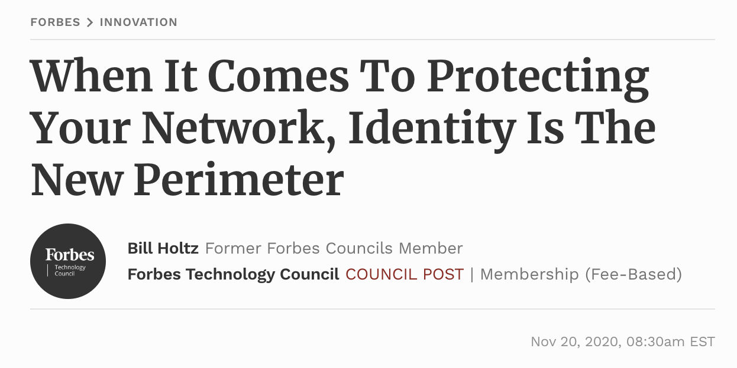
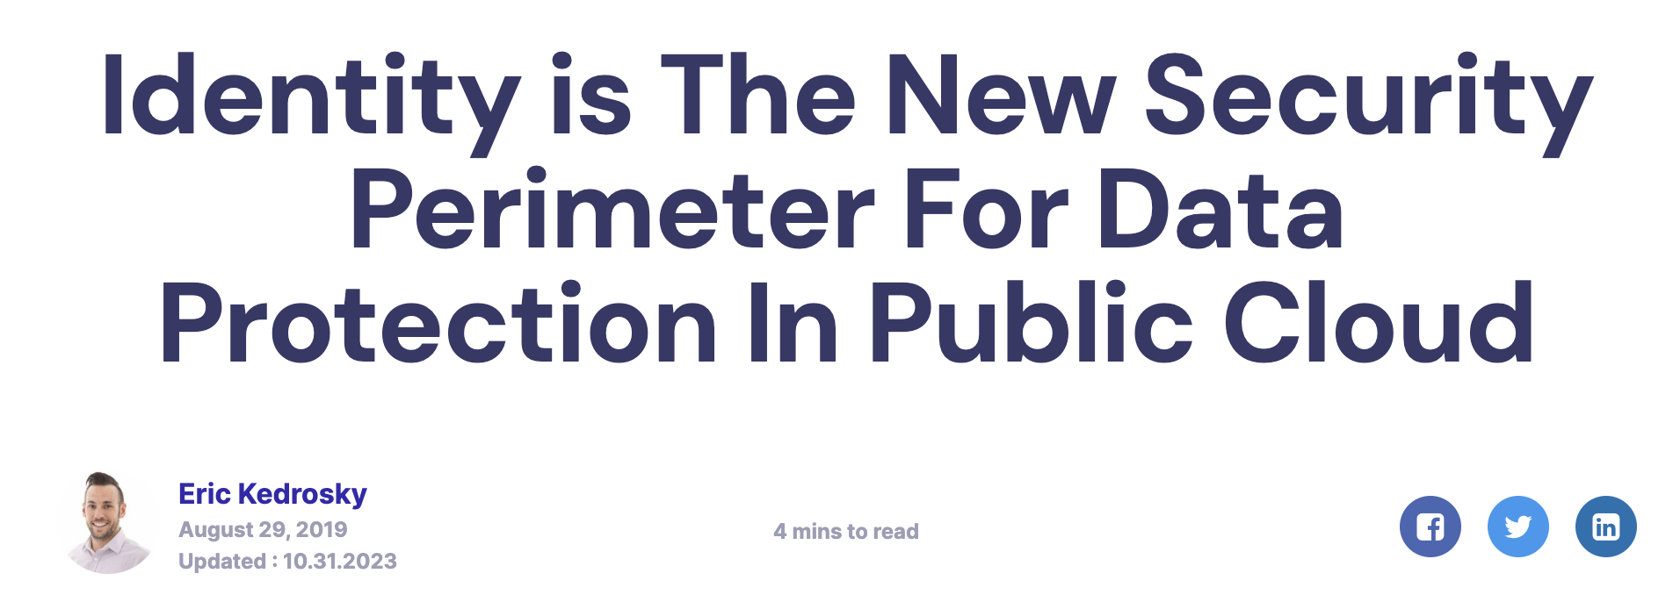
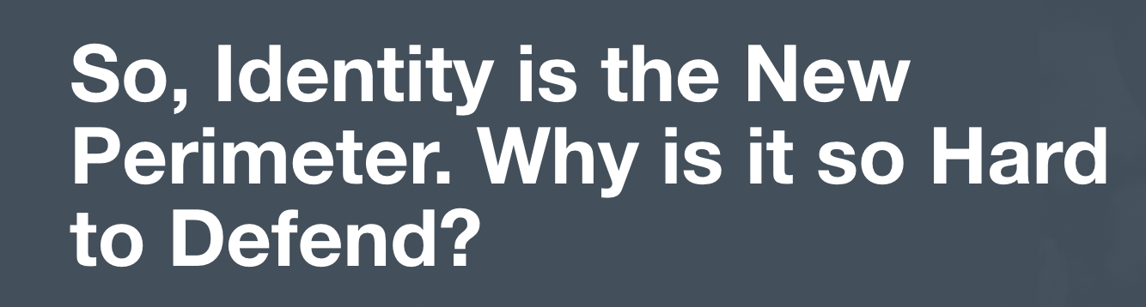
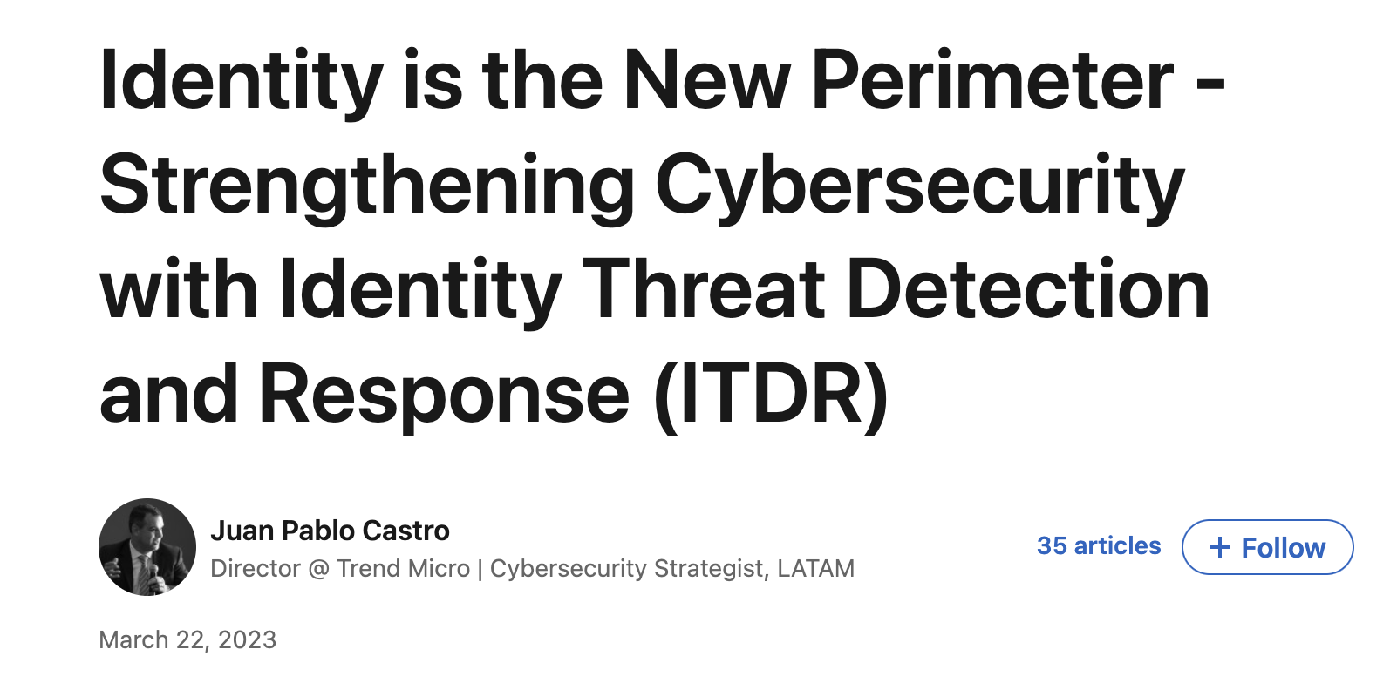
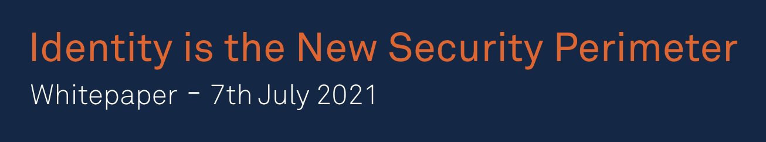
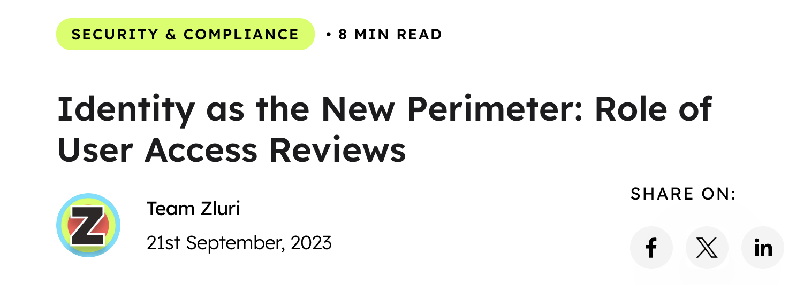
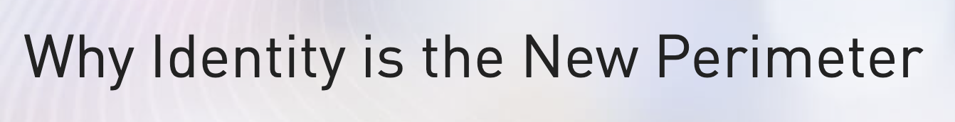
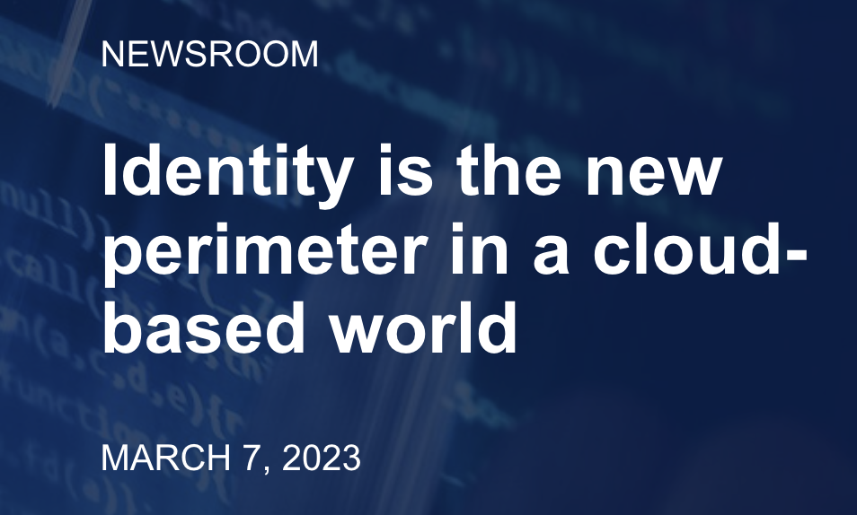
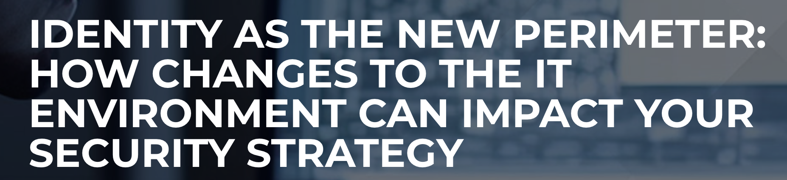
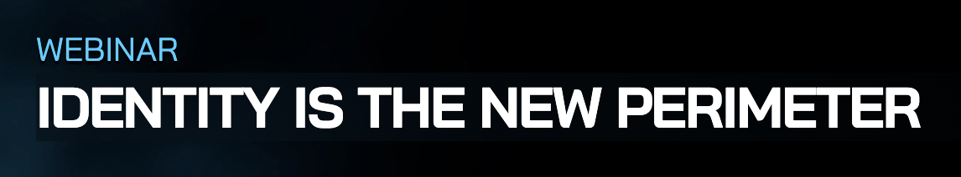
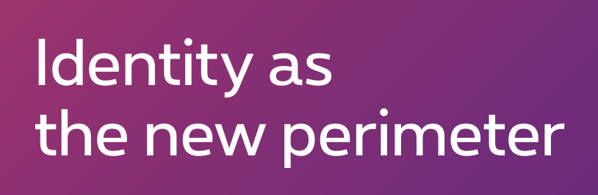
Identity is the new Perimeter

Slide 4

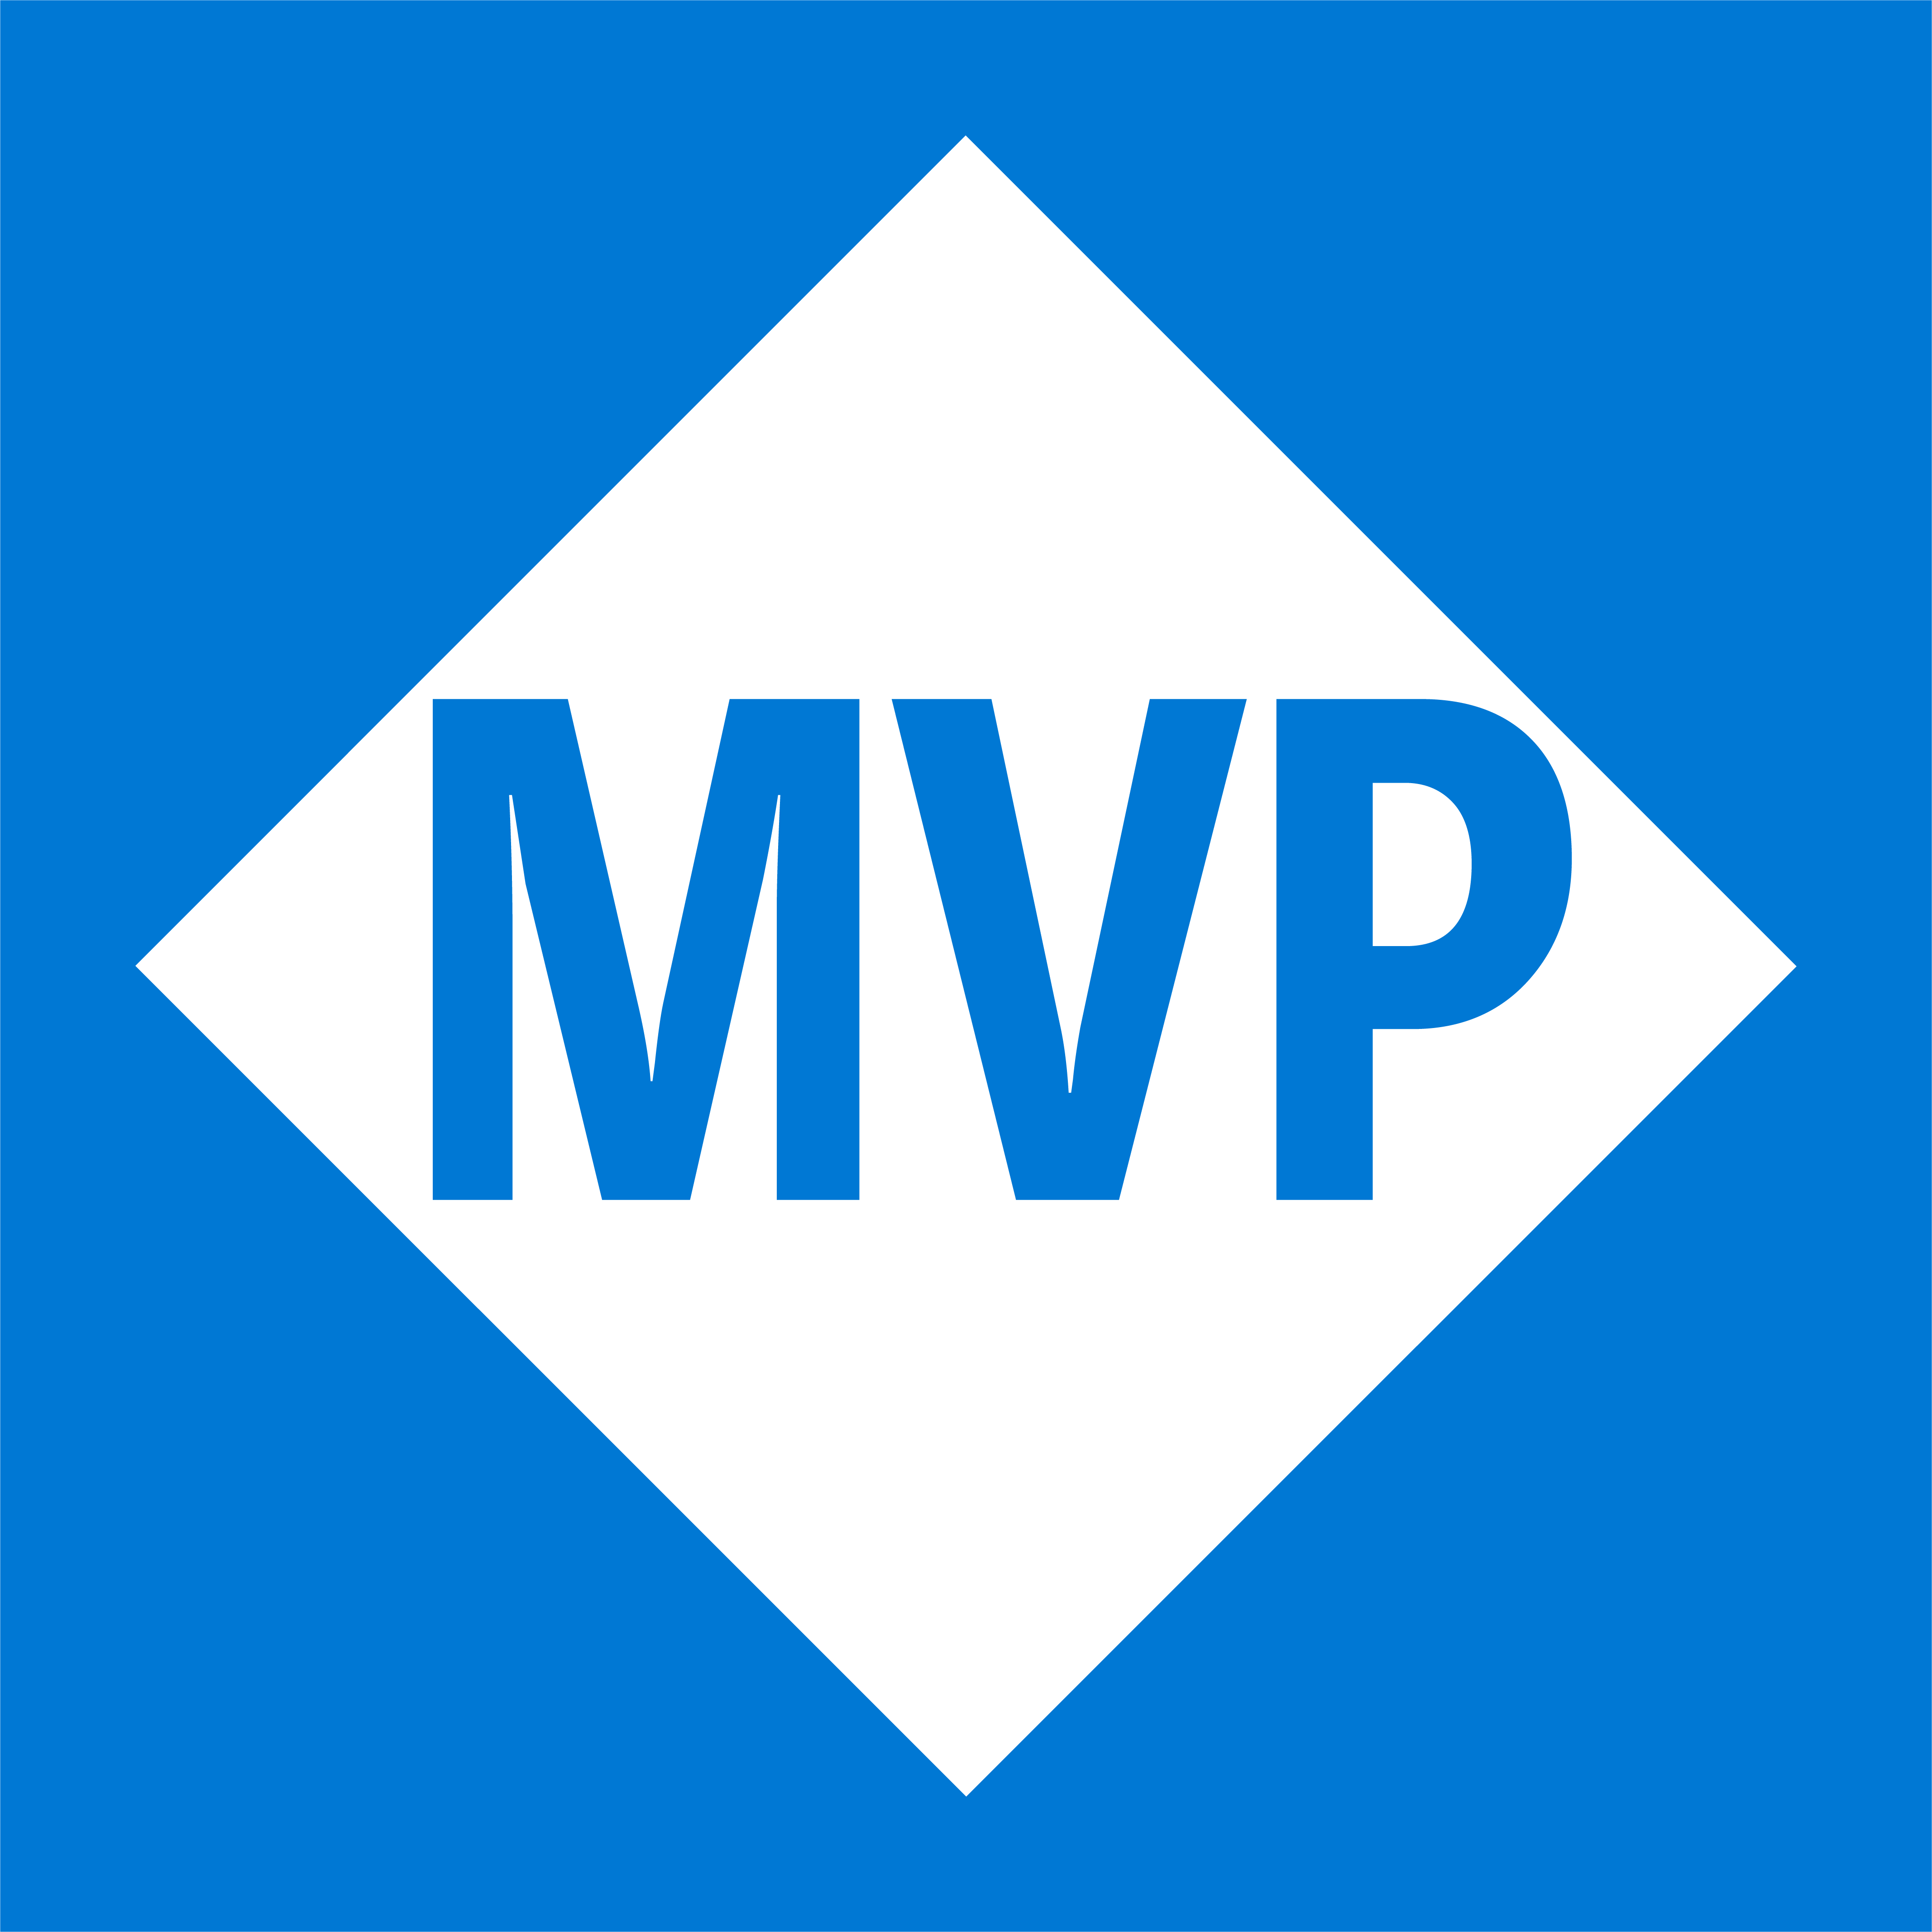
Emanuel Palm
💙 Everything-as-Code
📦 Makes modules & tools
📃 Fan of Open Source
☁️ Blogs at pipe.how
Fun facts!
☕️ Coffee roasting
🎲 Dungeons & Dragons
🥏 Disc Golf
🇸🇪
Cloud Specialist, Microsoft MVP
@PalmEmanuel

Slide 5
What is the State of Cloud Permissions?

Slide 6
?:1
10:1
Workload Identities
compared to Human Identities
???
?%
40 000
1%
permissions across clouds
of granted permissions are actually used
> 50% are high risk
?%
?%
60%
>50%
of all identities are
of all identities are
Inactive
“Super Admins”
2023 State of Cloud Permissions Risks Report
https://aka.ms/cloudpermissionsrisksreport
Notes:
High risk permissions can cause catastrophic damage if used improperly

Slide 7

Let’s Talk Security
40 000 permissions across clouds
> 50% are high risk
10:1 Workload Identities to Human
> 50% of identities are “super admins”
60% of all identities are inactive, 80% of workload identities (90 days)
1% of granted permissions are used
2023 State of Cloud Permissions Risks Report
https://aka.ms/cloudpermissionsrisksreport

Slide 8
Session Overview
Identity Types
Credentials
Applications & Resources
Permissions & Scopes
Tokens &
Auth Flows
Summary
Questions

Slide 9

Session Overview
Questions
Identity Types
Credentials
Applications & Resources
Discussion
Discussion
Discussion
Permissions & Scopes
Tokens & Auth Flows
Summary
Lunch
Discussion
Discussion
Discussion
Discussion

Slide 10

Identity Types
🙂
🤖
Human Identities
Machine Identities

Slide 11
Identity Types
🤖
🙂
💻
📦
Human Identities
Device Identities
Workload Identities

Slide 12

Workload Identity Types
“A collection of application resources, data, and supporting infrastructure that function together towards a defined business goal.”
- Microsoft Azure Well-Architected Framework

Slide 13
Workload Identity
“In Microsoft Entra, workload identities are applications, service principals and managed identities.”
- Microsoft Entra Workload ID documentation

Slide 14

Service Accounts?
“There are three types of service accounts native to Microsoft Entra ID: Managed identities, service principals, and user-based service accounts.”
- Microsoft Entra documentation

Slide 15


Workload Identity Types
App Registration
Enterprise Application
Application
Service Principal

Slide 16

Entra Tenant
Application
Service Principal

Slide 17

Workload Identity Types
User-Assigned Managed Identity
System-Assigned Managed Identity
Application
Service Principal

Slide 18
Application
Service Principal
User-Assigned Managed Identity
System-Assigned Managed Identity

Slide 19


Federated Credential
🪪
Secret📝
Certificate🔑
Registered in a single tenant Needs Service Principal(s) for operations
Application
✅
✅
✅
✅
✅
❌
Service Principal
Created for an application in a tenant *
User-Assigned Managed Identity
Connected to one or multiple Azure services Has its own resource in Azure
❌
✅
System-Assigned Managed Identity
❌
❌
Fully managed by an Azure service ♻️

Slide 20






Application Registrations
Authentication
Credentials
🔓
Identity (can be issued tokens)
Single-tenant
Public
Multi-tenant
Confidential
🔐
API
(can be a token audience)
Application Manifest
Configuration
Branding
Notes:
https://learn.microsoft.com/en-us/entra/identity-platform/reference-app-manifest

Slide 21

Demo Time
Notes:
35min

Slide 22


Entra ID
1. Consent
2. Login 3. Token
App Registration
Request (with Client Id)
Microsoft Graph API
Access Token
Get Client Id
Azure PowerShell 1950a258-227b-4e31-a9cf-717495945fc2
User
Notes:
https://learn.microsoft.com/en-us/troubleshoot/azure/entra/entra-id/governance/verify-first-party-apps-sign-in
List of a bunch of Microsoft application IDs
Some first-party (Microsoft) applications don’t show up with Service Principals in your tenant, such as Azure PowerShell. You can however technically create a service principal for your tenant and extend its permissions.

Slide 23
OAuth 2.0
Client
Authorization Server
Resource Server
Resource Owner
Notes:
https://learn.microsoft.com/en-us/troubleshoot/azure/entra/entra-id/governance/verify-first-party-apps-sign-in
List of a bunch of Microsoft application IDs
Some first-party (Microsoft) applications don’t show up with Service Principals in your tenant, such as Azure PowerShell. You can however technically create a service principal for your tenant and extend its permissions.

Slide 24
Azure APIs (OAuth Resources)
Represented by GUIDs
Can have URLs too
Microsoft Graph
https://graph.microsoft.com/
00000003-0000-0000-c000-000000000000
Azure Resource Manager
https://management.azure.com/
Azure DevOps
499b84ac-1321-427f-aa17-267ca6975798

Slide 25
Well-known Applications
Represented by GUIDs
Useful for log monitoring
Azure PowerShell
1950a258-227b-4e31-a9cf-717495945fc2
Azure CLI
04b07795-8ddb-461a-bbee-02f9e1bf7b46
Azure Portal
c44b4083-3bb0-49c1-b47d-974e53cbdf3c
Verify first-party Microsoft applications in sign-in reports
https://learn.microsoft.com/en-us/troubleshoot/azure/entra/entra-id/governance/verify-first-party-apps-sign-in

Slide 26






Permissions
Graph
Azure / ARM

Slide 27
Microsoft Graph
https://graph.microsoft.com
API with many APIs within
Entra ID, SharePoint, Intune and more
Applications are granted permissions
Delegated / Application
Permissions need Consent
Identities or Groups are assigned roles
Built-in / Custom (P1 or P2)
Workload Identities can also have roles or groups. It’s complicated.

Slide 28

https://management.azure.com/
Azure Resource Manager
Azure Role-based Access Control (RBAC)
Role Definitions
Permissions
Actions and NotActions
DataActions and NotDataActions
Built-in or Custom
Role Assignments
Scope
Security Principal
Role (Definition)
Owner
"roleName": “Owner", "permissions": [
{
"actions": [ "*“ ],
"dataActions": [],
"notActions": [],
"notDataActions": []
}
]

Slide 29
What is
Least Privilege

Slide 30




Application Administrator
Project Collection Administrator
Owner
”Grants full access to manage all resources, including the ability to assign roles in Azure RBAC.”
”Users in this role can add, manage, and configure enterprise applications, app registrations and manage on-premises like app proxy.”
”Members of this application group can perform all privileged operations on the Team Project Collection.”
🤔

Slide 31




Azure
Azure DevOps
Service Principal
Privileged Identity Management
Resources
Azure Pipeline
Repository
🧑‍💻
Platform Engineer
👩‍💻
👨‍💻
Privileged Identity Management
Developer
Entra Administrator

Slide 32





“Bearer Token”
Access Token
Refresh Token
ID Token
Used for authorization
Used for API calls
Short-lived
Used to refresh tokens
Very sensitive
Long-lived
Used for authentication
Part of Open ID Connect
Short-lived

Slide 33
Install-Module
AzAuth

Slide 34
AzAuth
Get-AzToken
-Interactive
-DeviceCode

Slide 35
AzAuth
-Interactive
Get-AzToken
-DeviceCode
-ClientId $ClientId -ClientSecret $ClientSecret -TenantId $TenantId

Slide 36
AzAuth
-DeviceCode
Get-AzToken
-ClientId $ClientId -ClientSecret $ClientSecret -TenantId $TenantId
-ClientId $ClientId -ClientCertificate $ClientCertificate -TenantId $TenantId

Slide 37
AzAuth
-ClientId $ClientId -ClientSecret $ClientSecret -TenantId $TenantId
Get-AzToken
-ClientId $ClientId -ClientCertificate $ClientCertificate -TenantId $TenantId
-ClientId $ClientId -ClientCertificatePath $CertPath -TenantId $TenantId

Slide 38
AzAuth
-ClientId $ClientId -ClientCertificate $ClientCertificate -TenantId $TenantId
Get-AzToken
-ClientId $ClientId -ClientCertificatePath $CertPath -TenantId $TenantId
-ManagedIdentity

Slide 39
AzAuth
-ClientId $ClientId -ClientCertificatePath $CertPath -TenantId $TenantId
Get-AzToken
-ManagedIdentity
-WorkloadIdentity
–ExternalToken $IdToken
-TenantId $TenantId

Slide 40
AzAuth
-ManagedIdentity
Get-AzToken
-WorkloadIdentity
–ExternalToken $IdToken
-TenantId $TenantId
-TokenCache $CacheName -Username $Username
-TenantId $TenantId

Slide 41
AzAuth
-WorkloadIdentity
–ExternalToken $IdToken
-TenantId $TenantId
Get-AzToken
-TokenCache $CacheName -Username $Username
-TenantId $TenantId
-Resource $Resource -TimeoutSeconds $Timeout
-Scope $Scope
-Claim $Claims

Slide 42
AzAuth
-TokenCache $CacheName -Username $Username
-TenantId $TenantId
Get-AzToken
-Resource $Resource -TimeoutSeconds $Timeout
-Scope $Scope
-Claim $Claims

Slide 43

Demo Time
Notes:
35min

Slide 44
Summary

Slide 45
Recommendations
Don’t rely on the Azure Portal 💻
Use proper tools to alleviate complexity 🛠️
Stop making your identities overprivileged 🧐
@PalmEmanuel

Slide 46

Thank you!
@PalmEmanuel

